Slide 1
Advanced AI Therapy System with Emotion Recognition and Recommendation Engine
PIP2001 Capstone Project
Batch Number: 10
Student Name | Roll Number
Yadhunandhan R | 20211CIT0132
R Manisha | 20211CIT0104
Ashutosh Patil | 20211CIT0139
Kaveri C | 20211CIT0112
Under the Supervision of,
Ms. Sterlin Minish TN
School of Computer Science and Engineering
Presidency University

Slide 2
Introduction
Mental health challenges are on the rise globally, with millions of individuals facing conditions such as anxiety, depression, and stress. Despite the growing awareness, access to professional mental health care remains limited due to factors like cost, stigma, and shortage of professionals.
Artificial Intelligence (AI) has emerged as a transformative tool in addressing these challenges, offering innovative solutions through personalized recommendations and empathetic interactions. By integrating advanced technologies such as sentiment analysis and hybrid recommendation systems, AI can provide tailored support and guidance to individuals in need.
This project focuses on developing an Advanced AI Therapy System with Emotion Recognition and Recommendation Engine—a digital solution designed to provide human-like interactions while addressing mental health conditions. The system leverages a combination of:
Sentiment Analysis to understand the user’s emotional state.
Hybrid Recommendation Engine to suggest effective mental health strategies.
Conversational AI to deliver empathetic and natural responses.

Slide 3
Literature Review
S no | Research papers | Context
1 | Lalith Abualigah, Hamza Essam Alfar, Mohammed Shehab and Alhareth Mohammed Abu Hussein, “SENTIMENT ANALYSIS IN HEALTH CARE”., January 2020., DOI:10.1007/978-3-030-34614-0_7 | explores the use of sentiment analysis in deriving insights from patient-generated text data in healthcare. Sentiment analysis, a technique combining data mining and natural language processing (NLP),
2 | Siddharth Biju, Dolly Golani, Aditya Khatavkar, Noopur Lade, and Pratush Jadoun., “THERAPISTGPT:AN AI POWERED THERAPIST”., May 2023 | explores the development of an advanced conversational AI system designed to provide mental health support. Built using Natural Language Processing (NLP) and Machine Learning (ML), TherapistGPT addresses critical challenges such as the shortage of mental health professionals
3 | Riddhi Shetty, Ankita Bhosale, Pankaj Verma, Ashwini Phalke, “TITLE:AI-BASED HEALTHCARE CHATBOT”., May 2022 | This paper explores various efforts to develop AI-based healthcare chatbots and their unique approaches. Md. Moshiur Rahman’s chatbot used machine learning algorithms, with SVM performing the best, though it struggled with collecting detailed symptom data.
4 | Mark Lawrence, MD Istiyak , Mohd Aman., “HEALTHCARE CHATBOT SYSTEM”., March 2024 | This paper explores how healthcare chatbots are transforming medical services. Patil et al. developed chatbots to help people in rural areas or those struggling to access medical advice.
5 | Ayain John, Abhigna G, Adithi K V, Harusha R, Kavya A S ., “HEALTHCARE CHATBOT”., August 2022 ., | The paper highlights the growing role of healthcare chatbots in improving patient care and streamlining medical processes.

Slide 4
Literature Review
6 | Idayati Mazlan, Noraswaliza Abdullah, Norashikin Ahmad., “Exploring the Impact of Hybrid Recommender Systems on Personalized Mental Health Recommendations”., January 2023 . | This paper highlights the “Hybrid recommender systems” address the limitations of traditional methods, such as collaborative and content-based filtering, by integrating multiple techniques to improve accuracy, diversity, and personalization.
7 | Eshan Shinde, Mahesh Shendage, Rahul Patil., “Artificial Intelligence Therapist”., August 2022 | This paper outlines the development of an AI-based chatbot system designed to address mental health challenges by analyzing user emotions and offering personalized therapeutic recommendations.

Slide 5
Literature Review
8 | Prof. Mamta Madan, Ms. Rishima Madan, Dr Praveen Thakur., “Analyzing the patient sentiments in healthcare domain using Machine learning”., April 2024 | explores how machine learning can help analyse patient feedback to evaluate healthcare facilities. By focusing on aspects like cleanliness, doctor availability, and patient-doctor interactions, the study uses Python's Text Blob library to identify the sentiment (positive, negative, or neutral) in patient reviews.
9 | Ameen Abdullah Qaid Aqlan, B. Manjula and R. Lakshman Naik., “A Study of Sentiment Analysis: Concepts, Techniques, and Challenges”., January 2019 | This paper explores sentiment analysis (SA), a powerful tool for understanding emotions in text data from sources like social media, blogs, and customer reviews. It outlines the five stages of SA
10 | Eshan Shinde, Mahesh Shendage, Rahul Patil. “ARTIFICIAL THERAPIST”., August 2022 | This paper outlines the development of an AI-based chatbot system designed to address mental health challenges by analyzing user emotions and offering personalized therapeutic recommendations.

Slide 6
Literature Review
11 | David B. Olawade, Ojima Z. Wada , Aderonke Odetayo Aanuoluwapo Clement David-Olawade, Fiyinfoluwa Asaolu , Judith Eberhardt ., “ARTIFICIAL INTELLIGENCE THERAPIST”., November 2023 | This paper reviews the integration of Artificial Intelligence (AI) in mental healthcare, focusing on its applications, challenges, and future directions.
12 | Erion C, Maurizio Morisio “Hybrid Recommendation Sytem”. | This paper explores the generation and visualization of personalized explanations for hybrid recommender systems, focusing on enhancing recommendation quality through a hybrid probabilistic graphical model.
13 | Pigi Kouki, James Schaffer, Jay Pujara, John O’Donovan, Lise Getoor ., “Hybrid Recommender Systems: A Systematic Literature Review” ., March 2019 | The paper explores the generation and visualization of personalized explanations for hybrid recommender systems, which combine various data sources to improve recommendation quality.

Slide 7
Literature Review
14 | Mehdi Elahi , Danial Khosh Kholgh , Mohammad Sina Kiarostami , Mourad Oussalah , Sorush Saghari ., “Hybrid recommendation by incorporating the sentiment of product reviews” ., January 2023 | This study evaluates sentiment-aware hybrid recommender systems using Amazon Digital Music and Video Games datasets.
15 | P. Chinnasamy Ajmeera Kiran , Wing-Keung Wong , J. Chinna Babu , Ambeth Raja Osamah Ibrahim Khalaf ., “Health Recommendation System using Deep Learning-based Collaborative Filtering”., December 2023 . | The Health Recommendation System (HRS) leverages advanced deep learning techniques, combining the Restricted Boltzmann Machine (RBM) with the Coevolutionary Neural Network (CNN).

Slide 8
Existing method Drawback
Despite the advancements in mental health technologies, several key gaps persist:
Lack of human-like conversational AI: Current solutions often feel robotic and fail to establish an emotional connection with users.
Limited integration of sentiment analysis and recommendations: Most tools focus on either detecting emotions or providing generic suggestions, but rarely combine the two effectively.
Poor adaptability and personalization: Existing systems do not adequately account for user preferences or feedback, leading to less relevant recommendations.
Inadequate use of real-time feedback: There’s minimal emphasis on capturing and utilizing user feedback to improve the system’s recommendations over time.

Slide 9
Proposed Method
The proposed methodology involves multiple integrated components working seamlessly to deliver an effective AI therapist:
Sentiment Analysis Module:
Utilizes machine learning and NLP techniques to detect the user's emotional state (e.g., happy, sad, anxious).
Acts as the entry point for the system, guiding subsequent recommendations.
Hybrid Recommendation System:
Combines content-based filtering (matching user preferences with solutions) and collaborative filtering (leveraging insights from similar users).
Recommends personalized mental health solutions such as mindfulness, journaling, or therapy techniques.
Gemini API (Retrieval-Augmented Generation - RAG):
Converts recommendations into empathetic conversational outputs, such as: "I’m sorry you’re feeling low today. Have you tried journaling? It might help you express your emotions."
Captures user responses, such as “I don’t feel like journaling”, and refines future recommendations accordingly.

Slide 10
Proposed Method
6. User Feedback Mechanism:
Captures user responses, such as “I don’t feel like journaling”, and refines future recommendations accordingly.
Stores feedback in a CSV file to improve recommendation accuracy.
5. Deployment:
Developed using flask for backend, Firebase for database management, and a web-based frontend interface to ensure accessibility.

Slide 11
Objectives
The objectives of the AI therapist project are centered around delivering an impactful and user-friendly mental health solution:
Provide Human-like Interactions:
Design a conversational AI that mimics the empathetic and understanding tone of a therapist.
Accurate Emotion Detection:
Develop a robust sentiment analysis module to identify emotions such as sadness, anxiety, or happiness.
Use state-of-the-art Natural Language Processing (NLP) techniques for precise emotion classification.
Personalized Mental Health Recommendations:
Implement a hybrid recommendation system that tailors solutions based on the user's emotional state and preferences.
Provide recommendations for activities or therapies such as journaling, mindfulness, or cognitive behavioral techniques.
Feedback Integration for Adaptability:
Introduce a feedback mechanism to capture user responses about the suggested solutions.
Refine the system over time by incorporating feedback into the recommendation model to improve personalization.

Slide 12
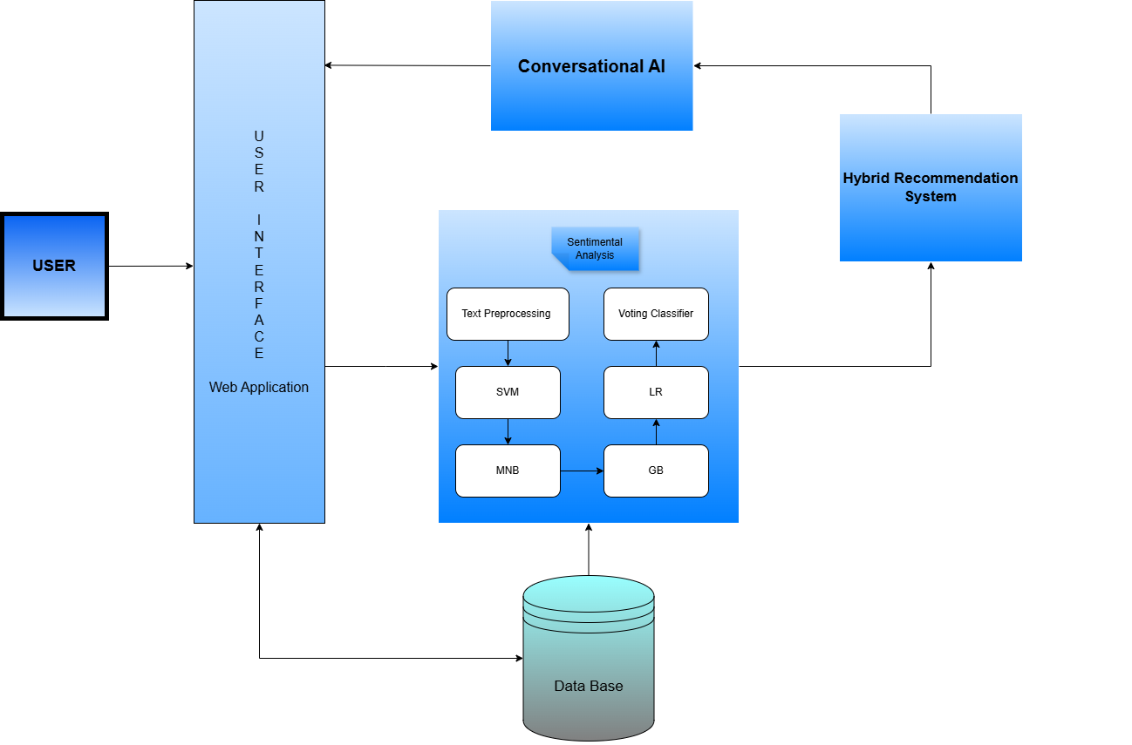
System Design and Implementation
ARCHITECTURE DIAGRAM

Slide 13
System Design and Implementation
The architecture starts with user input, which flows through the following stages:
1.Sentiment Analysis Module: To detect the user’s emotional state using pre-trained NLP models.
Uses libraries like TensorFlow or PyTorch for model development.
Employs sentiment classification techniques (e.g., BERT, GPT-based sentiment analysis).
Identifies emotions such as "Sad," "Happy," or "Anxious.“
2.Hybrid Recommendation Engine:To suggest personalized mental health solutions.
Combines content-based filtering (matching user preferences with solution characteristics) and collaborative
filtering (leveraging insights from similar users).
Uses algorithms such as cosine similarity for content filtering and matrix factorization for collaborative filtering.
3. Conversational AI (Gemini API):To convert technical outputs into empathetic and natural conversational
responses. Leverages the Gemini API (Retrieval-Augmented Generation - RAG) to create dialogue.
4.User Feedback Module: To capture feedback from users on the recommendations provided.
Creates a feedback form or dialogue option in the user interface (e.g., "Did this suggestion help you?").
Stores feedback in a CSV file for further analysis.
Updates the recommendation system by integrating feedback to refine future suggestions.

Slide 14
System Design and Implementation
5.Frontend and Backend:
Frontend:
Developed as a web-based interface with a dialogue-box-style UI for user interaction.
Frameworks like HTML, CSS, and JavaScript or ReactJS ensure a responsive design.
Backend:
Flask serves as the backbone for handling API requests and managing user data.
Firebase is used for real-time database management, storing user inputs, and feedback.

Slide 15
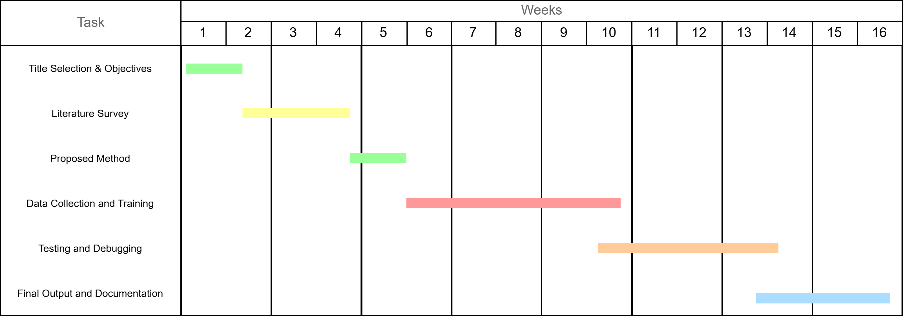
Timeline of Project

Slide 16
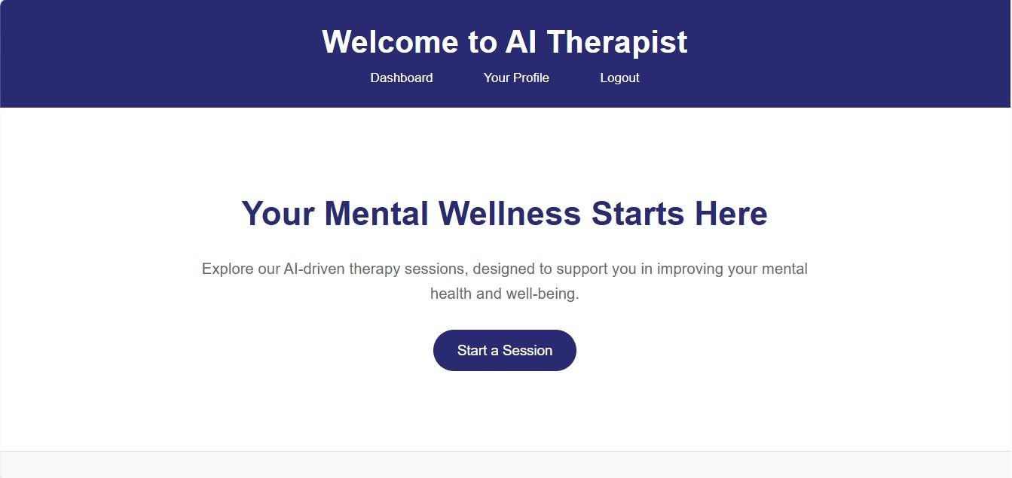
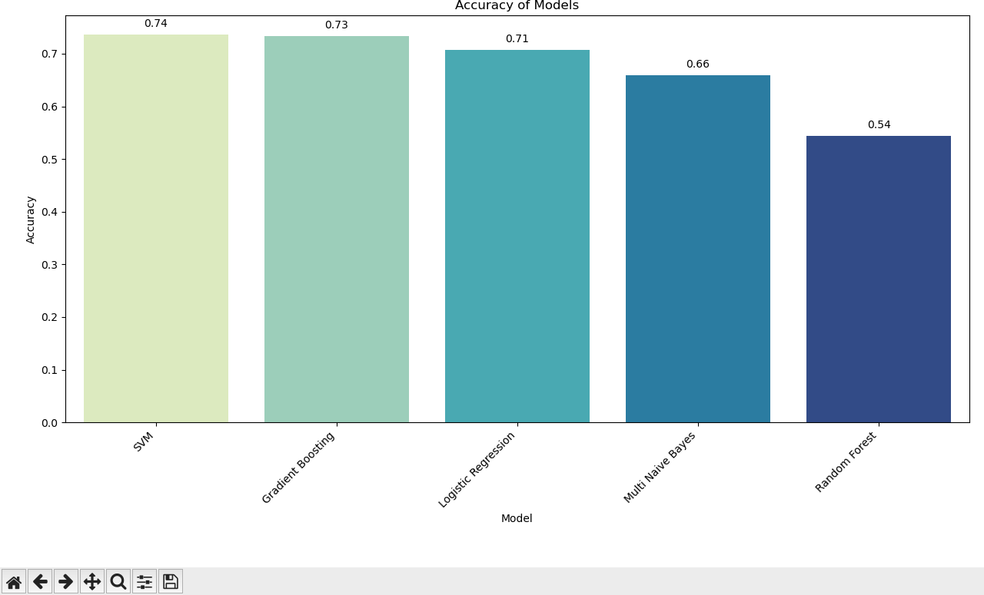
Outcomes

Slide 17
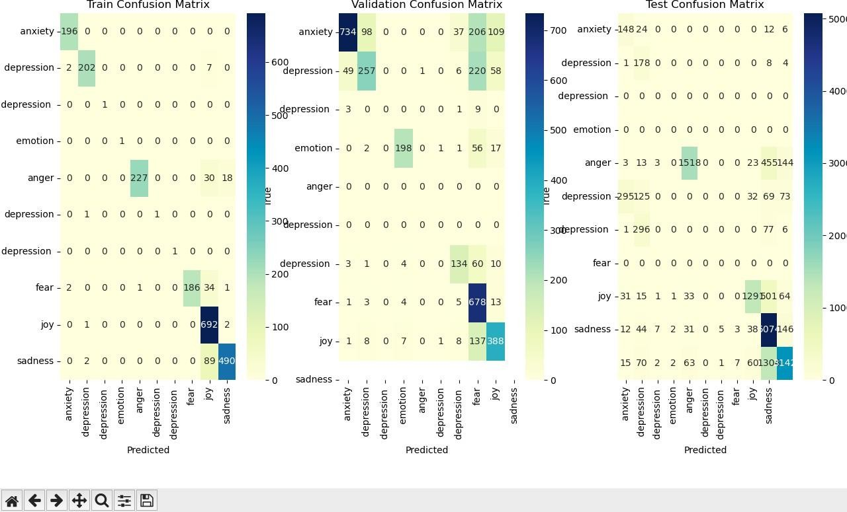
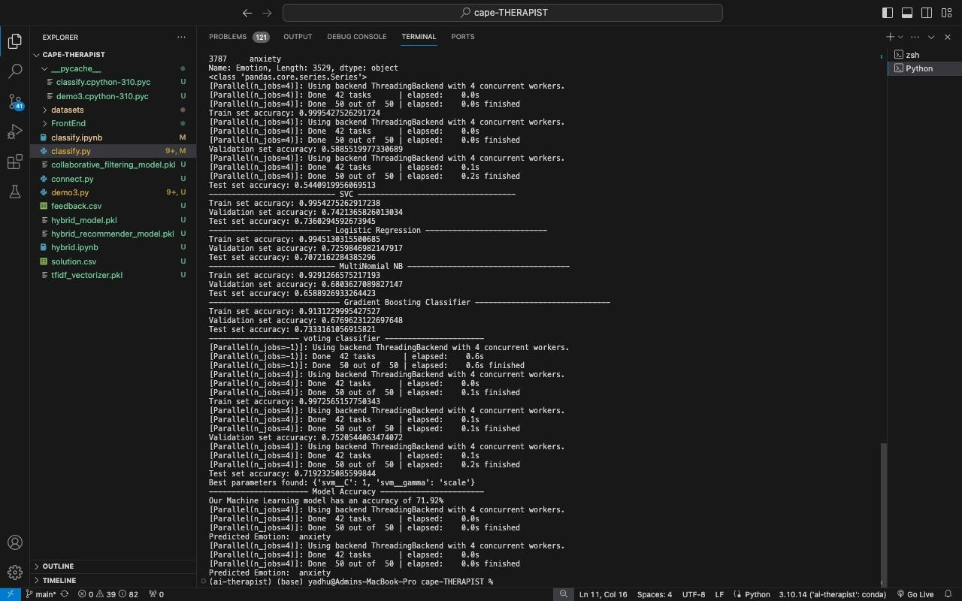
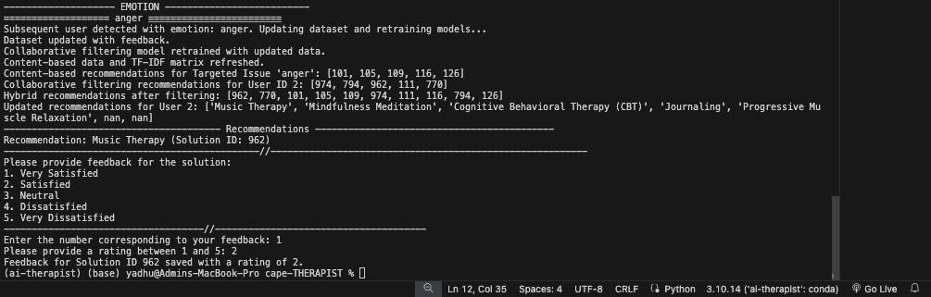
Outcomes

Slide 18
Conclusion
The AI therapist project demonstrates how advanced artificial intelligence can transform mental health support, offering a solution that is accessible, empathetic, and personalized. By integrating sentiment analysis, hybrid recommendation systems, and conversational AI, the system addresses key challenges in current digital mental health tools. The project’s unique approach allows for accurate detection of emotions, tailored suggestions based on user preferences, and human-like interactions that foster trust and engagement.
The inclusion of a feedback mechanism ensures the system continuously adapts to user needs, refining its recommendations to improve relevance and effectiveness over time. Furthermore, the deployment of a web-based interface makes the AI therapist widely accessible, ensuring users from diverse backgrounds can receive support.
Overall, the AI therapist project has the potential to revolutionize mental health care by bridging the gap between individuals and timely therapeutic guidance, paving the way for a future where mental health support is not only effective but also empathetic and deeply personalized.

Slide 19
References
[1] Eshan Shinde, Mahesh Shendage, Rahul Patil ,"ARTIFICIAL INTELLIGENCE THERAPIST",Research Gate Publications,August 2022.
[2] David B. Olawade, Ojima Z. Wada , Aderonke Odetayo , Aanuoluwapo Clement David- Olawade, Fiyinfoluwa Asaolu , Judith Eberhardt ,"ARTIFICIAL INTELLIGENCE THERAPIST",Journal of Medicine, Surgery, and Public Health Volume 3, August 2024, 100099.
[3] Erion C, Maurizio Morisio ,"Hybrid Recommender Systems: A Systematic Literature Review" ,ResearchGate Publications ,November 2017 Intelligent Data Analysis 21(6),1487- 1524,10.3233/IDA-163209.
[4] Pigi Kouki, James Schaffer, Jay Pujara, John O’Donovan, Lise Getoor ,"Hybrid Recommender Systems: A Systematic Literature Review" ,IUI '19: Proceedings of the 24th International Conference on Intelligent User Interfaces, March 2019.
[5] Mehdi Elahi , Danial Khosh Kholgh , Mohammad Sina Kiarostami , Mourad Oussalah , Sorush Saghari," Hybrid recommendation by incorporating the sentiment of product reviews",Information Sciences Volume 625, May 2023, Pages 738-756.
[6] P. Chinnasamy Ajmeera Kiran , Wing-Keung Wong , J. Chinna Babu , Ambeth Raja , Osamah Ibrahim Khalaf," Health Recommendation System using Deep Learning-based Collaborative Filtering", Published by Elsevier Ltd,Volume 9, Issue 12e22844December 2023.
[7] M.V.Patil , Subhawna, Priya Shree, Puneeth Singh," AI BASED HEALTHCARE CHAT BOT SYSTEM",ResearchGate Publications, July 2021 International Journal of Scientific and Engineering Research 12(7):668.
[8] Lalith Abualigah, Hamza Essam Alfar, Mohammed Shehab, Alhareth Mohammed Abu Hussein, "SENTIMENT ANALYSIS IN HEALTH CARE : A Brief Review", ResearchGate Publications, January 2020Studies in Computational Intelligence ,In book: Recent Advances in NLP: The Case of Arabic Language (pp.129-141) ,10.1007/978-3-030-34614-0_7.

Slide 20
References
[9] Siddharth Biju, Dolly Goplani, Aditya Khatavkar, Noopur Lade, and Pratush Jadoun," THERAPISTGPT:AN AI POWERED THERAPIST",International journal of creative research thoughts ,2023 IJCRT ,Volume 11, Issue 5 May 2023 ,ISSN: 2320-2882.
[10] Riddhi Shetty, Ankita Bhosale, Pankaj Verma, Ashwini Phalke," AI-BASED HEALTHCARE CHATBOT", SSRN ,Proceedings of the 7th International Conference on Innovations and Research in Technology and Engineering (ICIRTE-2022), organized by VPPCOE & VA, Mumbai-22, INDIA ,May 2022.
[11] Mark Lawrence, MD Istiyak , Mohd Aman," HEALTHCARE CHATBOT SYSTEM", International journal of novel research and development(IJNRD), 2024 IJNRD Volume 9, Issue 3 March 2024 ISSN: 2456-4184 ,March 2024.
[12] Ayain John, Abhigna G, Adithi K V, Harusha R, Kavya A S ,"HEALTHCARE CHATBOT" , ResearchGate Publications,International Research Journal of Computer Science 9(8):297- 303,August 2022, 10.26562/irjcs.2022.v0908.28.
[13] Idayati Mazlan, Noraswaliza Abdullah, Norashikin Ahmad,"Exploring the Impact of Hybrid Recommender Systems on Personalized Mental Health Recommendations" , ResearchGate Publications,International Journal of Advanced Computer Science and Applications 14(6), January 2023 ,License :CC BY 4.0.
[14] Eshan Shinde, Mahesh Shendage, Rahul Patil," Artificial Intelligence Therapist",International Research Journal of Modernization in Engineering Technology and Science Volume:03,April 2021.
[15] Prof. Mamta Madan, Ms.Rishima Madan, Dr Praveen Thakur," Analysing the patient sentiments in healthcare domain using Machine learning",Procedia Computer Science Volume 238, 2024, Pages 683-690 ,The 7th International Conference on Emerging Data and Industry (EDI40) April 23-25, 2024, Hasselt, Belgium.

Slide 21
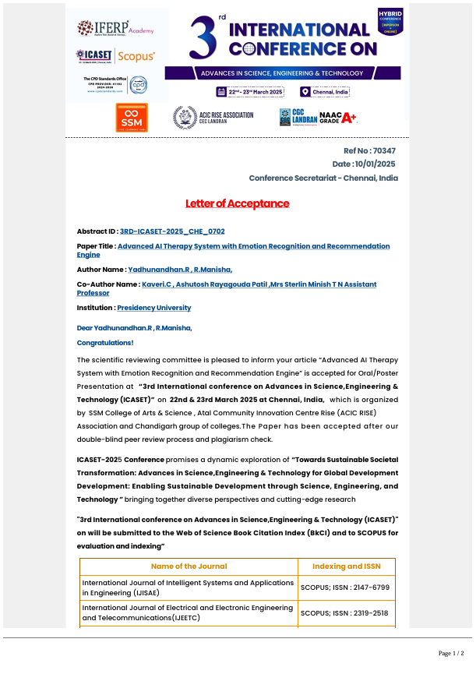
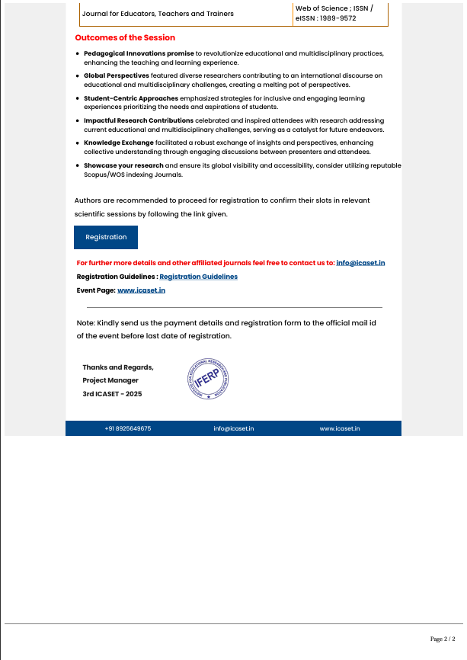
Publication Details

Slide 22
Thank You

